Slide 1
Spark GraphX
Big Data
29th October 2025

Slide 2
Social Media: Friend Recommendation
Scenario
Platforms like Facebook, LinkedIn, or Instagram manage billions of users and their relationships — friends, followers, likes, comments, tags, etc.
This data is highly connected, which makes it perfect for graph analysis.
How Big Data & Graphs Are Used
Data Structure
  Nodes: Users, posts, pages, groups, hashtags
  Edges: Follows, likes, comments, shares, tags
  This forms a massive social graph with billions of connections.
Graph Algorithms
  Follower Recommendation
  Influencer Detection
Big Data Integration
  Streams from millions of posts per second are ingested using Apache Kafka, analyzed in Apache Spark, and stored in graph databases like Neo4j or TigerGraph.
Example
  LinkedIn’s “People You May Know” feature uses a graph-based recommendation engine built on Hadoop + graph processing.
  Twitter uses graph analysis to recommend who to follow
Benefits
Highly personalized recommendations
Better community detection (e.g., topic clusters)
Real-time insights for trending content or fake account detection

Slide 3
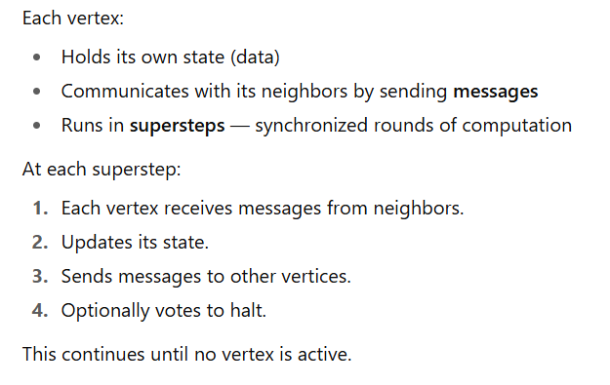
What is Pregel?
Pregel is a distributed graph processing model developed by Google (published in 2010).
It’s based on the vertex-centric idea — “Think like a vertex.”
Algorithm:

Slide 4
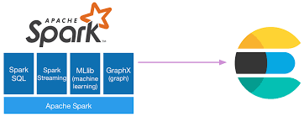
What is Spark GraphX ?
Part of Apache Spark for graph processing and graph-parallel computation
Allows to represent data as graphs (vertices + edges)
Supports both graph algorithms and data-parallel operations
Built on top of Spark’s RDD (Resilient Distributed Dataset)

Slide 5
Basic Commands
Basic graph creation
Step | Code | Description
Import packages | import org.apache.spark.graphx._ import org.apache.spark.rdd.RDD | Required for GraphX and RDDs
Define vertices | val vertices: RDD[(VertexId, String)] = sc.parallelize(Seq( (1L, "Alice"), (2L, "Bob"), (3L, "Charlie"), (4L, "David") )) | Each vertex has an ID and a label
Define edges | val edges: RDD[Edge[String]] = sc.parallelize(Seq( Edge(1L, 2L, "follows"), Edge(4L, 1L, "connects") )) | Each edge connects two nodes with a relationship
Create graph | val graph = Graph(vertices, edges) | Builds a directed graph

Slide 6
Frequent High Level Function
Function | Example | Description
map | rdd.map(x => x * 2) | Applies a function to each element to produce a new RDD of transformed elements.
filter | rdd.filter(x => x > 5) | Keeps only the elements that satisfy a condition.
distinct | rdd.distinct() | Removes duplicate elements from the RDD.
union | rdd1.union(rdd2) | Combines two RDDs of the same type into one.
intersection | rdd1.intersection(rdd2) | Returns only elements that exist in both RDDs.
subtract | rdd1.subtract(rdd2) | Removes elements in the second RDD from the first.
groupBy | rdd.groupBy(x => x % 2) | Groups elements according to a function or rule.
groupByKey | rdd.groupByKey() | Groups values with the same key (for key-value RDDs).
sortByKey | rdd.sortByKey(ascending = true) | Sorts key–value pairs by their key.
cache | rdd.cache() | Persists the RDD in memory for reuse in future actions.

Slide 7
Subgraph extraction
Operation | Syntax / Example | Description
filterVertices | graph.subgraph(vpred = (id, attr) => attr.startsWith("A")) | Filter vertices only.
filterEdges | graph.subgraph(epred = triplet => triplet.attr == "follows") | Filter edges only.
joinVertices | graph.joinVertices(newVertexRDD){ (id, oldAttr, newAttr) => updatedAttr } | Updates vertex attributes by joining with another VertexRDD. Useful for adding computed values like degrees or ranks.
vertices.join | graph.vertices.join(vertexRDD) | Joins two VertexRDDs to combine attributes. Returns (vertexId, (attr1, attr2)).
edges.map | graph.edges.map(e => (e.srcId, e.dstId)) | Extract source-destination info from edges; often used before joins or subgraph creation.
triplets | graph.triplets | Accesses source vertex, edge, and destination vertex for more complex filtering or join operations.

Slide 8
Graph Information
Operation | Code | Description
View vertices | graph.vertices.collect.foreach(println) | Shows all vertex IDs and labels
View edges | graph.edges.collect.foreach(println) | Lists all edges (source, destination, label)
Human-readable view | graph.triplets.collect.foreach(t => println(s"${t.srcAttr} --${t.attr}--> ${t.dstAttr}")) | Prints relations like “Alice --follows--> Bob”
In-degree | graph.inDegrees.collect.foreach(println) | Incoming edges count for each vertex
Out-degree | graph.outDegrees.collect.foreach(println) | Outgoing edges count for each vertex
Total degree | graph.degrees.collect.foreach(println) | Total degree (in + out) for each vertex
Outgoing neighbors | graph.triplets.map(t => (t.srcAttr, t.dstAttr)).groupByKey().collect() | Lists who each node points to
Incoming neighbors | graph.triplets.map(t => (t.dstAttr, t.srcAttr)).groupByKey().collect() | Lists who points to each node

Slide 9
Reverse graph
Operation | Code | Description
Reverse edges | val reversedGraph = graph.reverse | Reverses the direction of all edges
View reversed graph | reversedGraph.triplets.collect.foreach(t => println(s"${t.srcAttr} --${t.attr}--> ${t.dstAttr}")) | Displays the reversed edge directions
Save and Load Graph(text)
Operation | Code | Description
Save graph | graph.vertices.saveAsObjectFile("vertices_obj") graph.edges.saveAsObjectFile("edges_obj") | Reverses the direction of all edges
Load graph | val vertices = sc.objectFile[(Long, String)]("vertices_obj") val edges = sc.objectFile[Edge[String]]("edges_obj") | Displays the reversed edge directions
Miscellaneous:
Use :help to get reference list of basic commands
Use :type for any variable to know its datatype
Use .collect() only when you need final calculation
Use .cache() for a variable if you are going to use it often

Slide 10
Built-in GraphX Algorithm
Operation | Code | Description
Page Rank | graph.pageRank(tol) graph.pageRank(numIter = n) | New Graph with rank as vertex attributes
Connected Component | graph.connectedComponents() | New Graph with component number as attribute
Strongly Connected Component | graph.stronglyConnectedComponents(numIter) | New Graph with component number as attribute
Triangle Count | graph.triangleCount() | New Graph with number of participating triangle
Shortest Path Length | ShortestPaths.run(graph, Seq(1L)) | New Graph with Shortest path length to selected node(1L) as attribute
Label Propagation | LabelPropagation.run(graph, maxIter = 10) | Detect Communities

Slide 11
Page Rank
PageRank is an algorithm that measures the relative importance of each vertex in a graph based on its connections.
A rank score based on how many links it has and the importance of those linking vertices.
Method Variants
graph.pageRank(tol: Double)
tol → stop when PageRank values converge (change < tolerance)
graph.pageRank(numIter: Int)
numIter → run for a fixed number of iterations
Both return a Graph[Double, Double]:
Vertex attribute → PageRank score
Edge attribute → normalized contribution weight

Slide 12
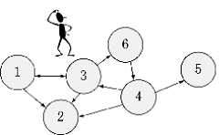
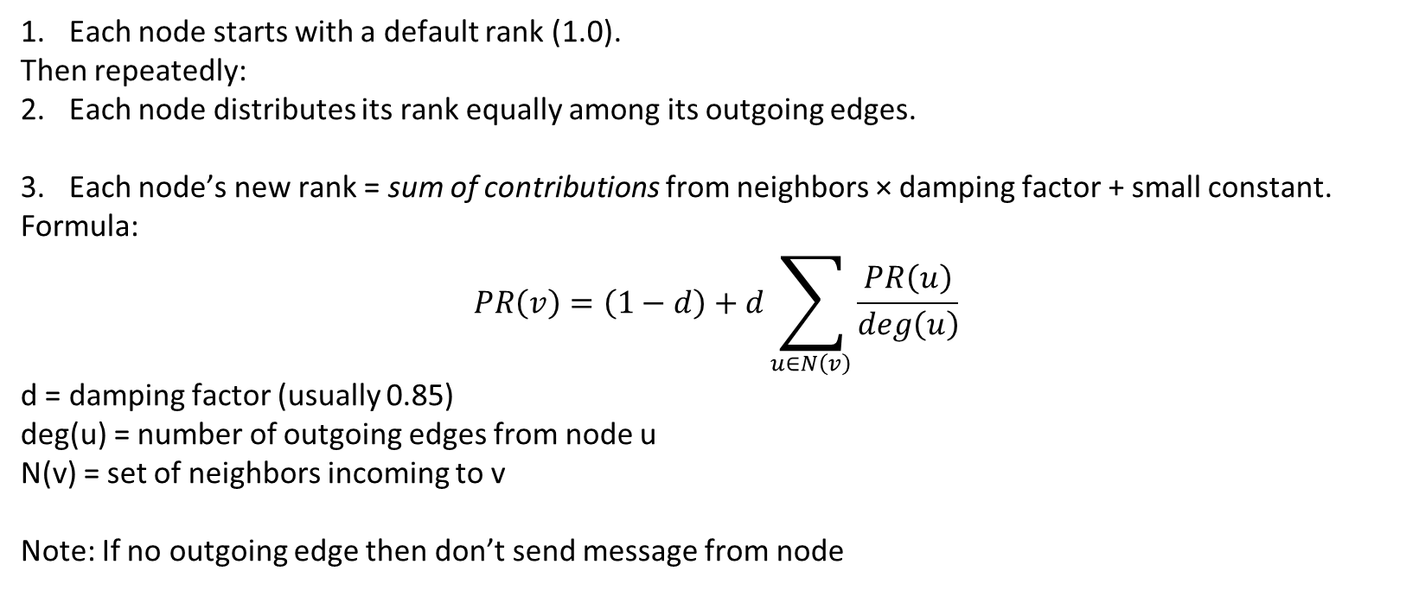
Page Rank : Algorithm
Each node starts with a default rank (1.0).
Then repeatedly:
Each node distributes its rank equally among its outgoing edges.
Each node’s new rank = sum of contributions from neighbors × damping factor + small constant.
Formula:
$$PR\left(v\right)=\left(1−d\right)+d\sum_{u∈N\left(v\right)}{\frac{PR\left(u\right)}{deg\left(u\right)}}$$
d = damping factor (usually 0.85)
deg(u) = number of outgoing edges from node u
N(v) = set of neighbors incoming to v
Note: If no outgoing edge then don’t send message from node

Slide 13
Strongly Connected Component
A strongly connected component (SCC) in a directed graph is a maximal set of vertices where each vertex is reachable from every other vertex in that set.
Once the SCCs are identified, the graph can be simplified by collapsing each SCC into a single node. The resulting "condensed graph" is a directed acyclic graph (DAG), which is easier to analyze
Method
graph.stronglyConnectedComponents(numIter:Int)
numIter -> maximum number of iterations (stopping condition)
Method returns a Graph[VertexId, ED]:
Vertex attribute → lowest vertex ID in its strongly connected component

Slide 14
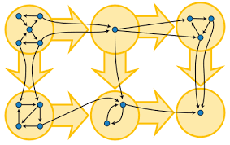
Strongly Connected Component: Algorithm
Algorithm is based on a label propagation style technique:
Each vertex starts labeled with its own ID.
Iteratively, every vertex propagates and updates its label to the minimum vertex ID reachable through its incoming and outgoing edges.
This continues until labels stop changing or until numIter is reached

Slide 15
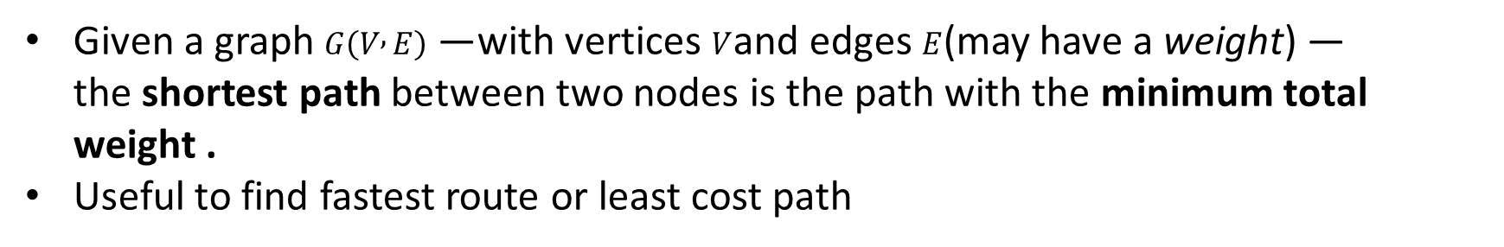
Shortest Paths
Given a graph $G\left(V , E\right)$— with vertices $V$and edges $E$(may have a weight) —
the shortest path between two nodes is the path with the minimum total weight .
Useful to find fastest route or least cost path
Method
import org.apache.spark.graphx.lib.ShortestPaths
Needed Import
ShortestPaths.run(graph, landmarks)
graph → Graph[VD, ED]
Landmarks → sequence of source vertex IDs
Both return a Graph[Map[VertexId, Int], ED]:
Vertex attribute → Map from each landmark ID to the shortest distance

Slide 16
Shortest Paths: Algorithm
GraphX uses a distributed variant of the Breadth-First Search (BFS) algorithm to compute shortest paths:
Start from landmark nodes with distance 0.
All other vertices start with distance ∞ (unreachable).
Iteratively:
  Each vertex sends its known distances + edge weights to its neighbors.
  Neighbors update their shortest known distance if a shorter path is found.
Repeat until no updates happen.

